Slide 1

NML Progres
OGF 28, München

Slide 2
OGF IPR Policies Apply
“I acknowledge that participation in this meeting is subject to the OGF Intellectual Property Policy.”
Intellectual Property Notices Note Well: All statements related to the activities of the OGF and addressed to the OGF are subject to all provisions of Appendix B of GFD-C.1, which grants to the OGF and its participants certain licenses and rights in such statements. Such statements include verbal statements in OGF meetings, as well as written and electronic communications made at any time or place, which are addressed to:
the OGF plenary session,
any OGF working group or portion thereof,
the OGF Board of Directors, the GFSG, or any member thereof on behalf of the OGF,
the ADCOM, or any member thereof on behalf of the ADCOM,
any OGF mailing list, including any group list, or any other list functioning under OGF auspices,
the OGF Editor or the document authoring and review process
Statements made outside of a OGF meeting, mailing list or other function, that are clearly not intended to be input to an OGF activity, group or function, are not subject to these provisions.
Excerpt from Appendix B of GFD-C.1: ”Where the OGF knows of rights, or claimed rights, the OGF secretariat shall attempt to obtain from the claimant of such rights, a written assurance that upon approval by the GFSG of the relevant OGF document(s), any party will be able to obtain the right to implement, use and distribute the technology or works when implementing, using or distributing technology based upon the specific specification(s) under openly specified, reasonable, non-discriminatory terms. The working group or research group proposing the use of the technology with respect to which the proprietary rights are claimed may assist the OGF secretariat in this effort. The results of this procedure shall not affect advancement of document, except that the GFSG may defer approval where a delay may facilitate the obtaining of such assurances. The results will, however, be recorded by the OGF Secretariat, and made available. The GFSG may also direct that a summary of the results be included in any GFD published containing the specification.”
OGF Intellectual Property Policies are adapted from the IETF Intellectual Property Policies that support the Internet Standards Process.
Notes:
IPR Notices Note Well for OGF meetings

Slide 3
Agenda
15:00
15:10
15:20
15:30
16:00
17:00
17:30
18:00
Agenda & note taker & Overview
Network concepts proposal
Adaptation concepts proposal
Addenda to & vote on proposals
NSI Request on Network Topology – John Vollbrecht
Discussion on cross-connects (configuration)
Discussion on links and channels
Discussion on end-to-end path
Notes:
Notes OGF27 not on list.
Decision: consensus on terminology, move forward and put them in schema

Slide 4
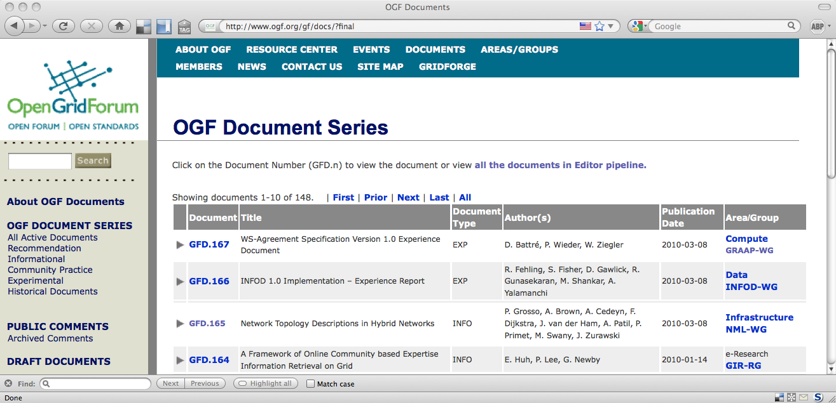
GFD.165
Thanks Paola Grosso, Aaron Brown, Aurélien Cedeyn, Freek Dijkstra, Jeroen van der Ham, Anand Patil, Pascale Primet, Martin Swany, and Jason Zurawski.

Slide 5

Concepts (a.k.a. buckets)
Devices (node, port)
Network (topology, domain)
Adaptation
Links and channels
Cross-connects and channels (configuration)
End-to-end path
Capabilities (services)
Notes:
Cross connects incl. multicast, broadcast, fall-over connections)

Slide 6
OGF27: Topical Volunteers
Device / Node / Port concepts
Network / Topology / Domain concept Inder, Jeroen
Adaptation / Layer concept Freek, Jeroen
Capabilities / Service concept Martin
Link / Path / Segment concepts Martin, Chin
Syntax representation, Identifiers Freek
Cross-connects and channels

Slide 7
OGF27: Service Example Volunteers
Adaptation Service Jeroen
Switching Matrix Service Jeroen
Segment Concatenation Service John
Multicast Service Petr
Label Conversion Service Freek
Data Transport Service Freek
Measurement Point Service
Virtualization Service
Lookup Service Gigi
Path Finding Service

Slide 8
Long Term Progres
Decide on terminology
Merge in schema
Refine based on requirements / use cases
Create syntax
Write the bloody document now, shall we!?
Notes:
Cross connects incl. multicast, broadcast, fall-over connections)

Slide 9
Network Terminology
Inder Monga and Jeroen van der Ham

Slide 10
Network Terminology
Topology: A set of Network Elements and the links connecting them.
NetworkDomain: An unordered collection of Network Elements managed under the same shared policy umbrella.

Slide 11
Adaptation Terminology
Jeroen van der Ham and Freek Dijkstra

Slide 12
Adaptation Terminology (1)
Layer: A collection of Ports with common Characteristic Information.
AdaptationType: Abstract type describing the technology of embedding the data of one layer into the data of another layer.
AdaptationService: Adaptation capability in a topology or node.
Adaptation: Actual data transport function where data of one port is embedded in the data of another port. (A configured AdaptationService, or a static component)
Notes:
Characteristic Information is defined in G.800

Slide 13
Adaptation Terminology (2)
Adaptation can be part of a Topology or Node, not be part of a cross-connect in a SwitchMatrix.
AdaptationService can be part of a Topology or Node, not be part of a SwitchMatrixService.
PortGroup: a collection of zero or more Ports in a Node or a Topology. (PortGroups can be used to describe between which Ports an Adaptation can be created from an AdapatationService, or similarly between which Ports a cross-connect can be made in a SwitchMatrix.)
Notes:
AdaptationSource = adaptation
AdaptationSInk = de-adaptation

Slide 14
Adaptation Terminology (3)
AdaptationSource: Embedding of data from a client port into a server port. (adaptation)
AdaptationSink: Extraction of data out of a server port into a client port. (de-adaptation)
AdaptationSourceService: AdaptationSource capability in a topology or node.
AdaptationSinkService: AdaptationSink capability in a topology or node.

Slide 15
Service Terminology
Martin Swany

Slide 16
Service Terminology
"A Service object describes a certain capability being offered by a network object.”

Slide 17
Addenda to Proposals

Slide 18
Yeah or Nay
Start
Current Proposal OK?
Authors willing to revise?
no
no
yes
yes
Integrate in document
Back to the drawing board
New volunteers

Slide 19
Some Questions
Network
Relation topology:domain 1:1, many:1 or 1:many?
Why is domain only for a network, considering the "any IT" mention in infrastructure service BoF?
Is there input from the recent topology discussion in the NSI?
Adaptation
no multiplexing/inverse multiplexing

Slide 20
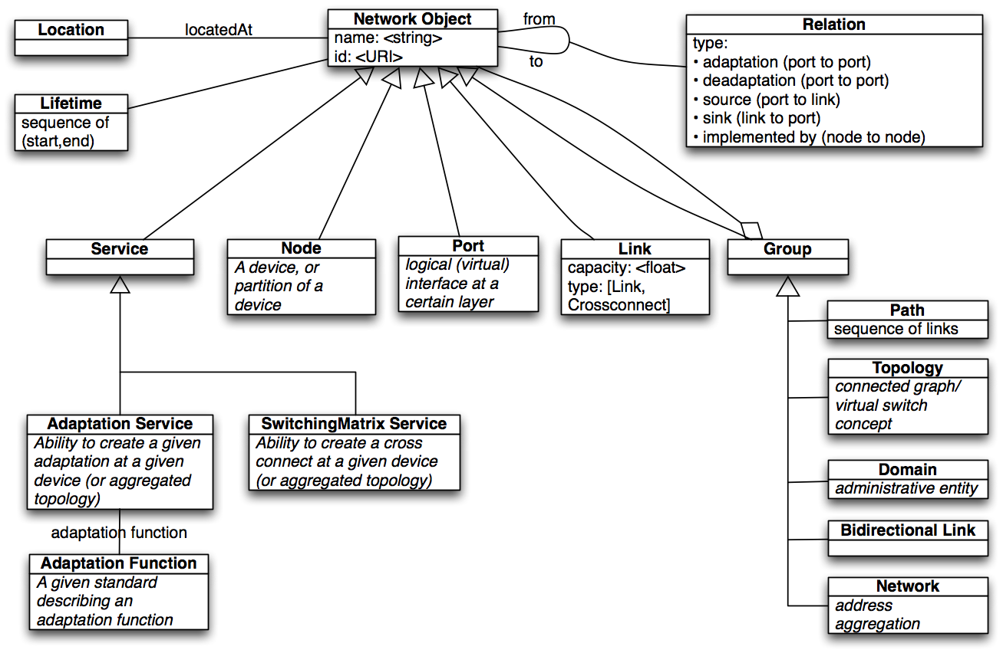
Current Schema

Slide 21
Full Copyright Notice
Copyright (C) Open Grid Forum (2010). All Rights Reserved.
This document and translations of it may be copied and furnished to others, and derivative works that comment on or otherwise explain it or assist in its implementation may be prepared, copied, published and distributed, in whole or in part, without restriction of any kind, provided that the above copyright notice and this paragraph are included on all such copies and derivative works.
The limited permissions granted above are perpetual and will not be revoked by the OGF or its successors or assignees.
Notes:
OGF Full Copyright Notice if necessary

